Slide 1
DML Triggers

Slide 2
Objectives
At the end of this session, the participants will be able to:
    Understand database triggers and their need
    Differentiate between stored procedures and triggers
    Identify the trigger types
    Create statement and row level DML triggers

Slide 3
Agenda
What is a Database Trigger?
Difference between Stored Procedures and Database Triggers
Trigger Types
DML Trigger Components
Creating DML Triggers
  BEFORE /AFTER
  STATEMENT/ROW

Slide 4
Database Triggers
Triggers are named PL/SQL blocks with declarative, executable, and exception handling sections
A trigger is executed implicitly whenever the triggering event takes place
Triggers do not accept arguments
Like packages, triggers are stored database objects and can not be local to a block

Slide 5
Stored Procedures vs Database Triggers
Stored Procedures | Triggers
A procedure is called explicitly by a user, application or a trigger | A trigger executes implicitly in response to an event, such as an update operation on a table
Can not be inactive | We can enable and disable according to the need
Can have parameters | Can not have parameters
No restriction on the size of a procedure | There may be a restriction on the size of a trigger depending on the version of oracle used

Slide 6
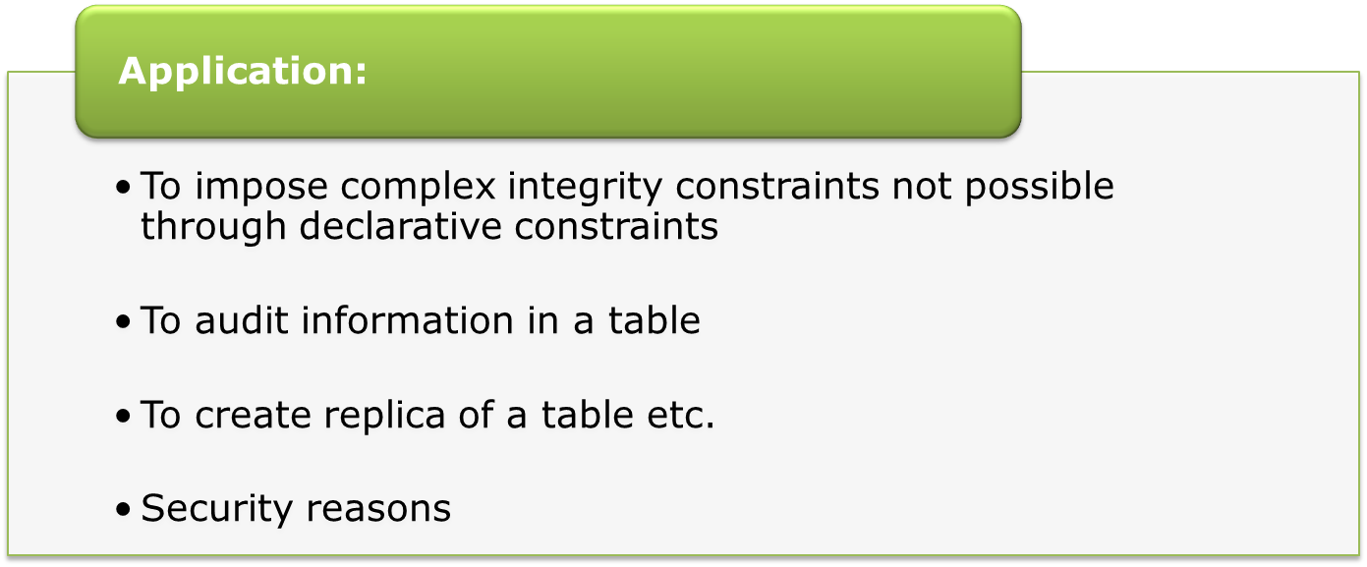
DML Triggers
Notes:
Triggers can enforce complex integrity rules.
Example: A trigger can ensure that employee's new salary is within the job classification's limits. This cannot be done with constraints.
Triggers can be used to monitor and store the history of changes made to a table.
Example: A trigger can track the changes made to the EMP table, which row/s was inserted, updated, deleted, when the operation was performed and which user made this change. All this information can be stored in a table.
Triggers can be used to create a replica of tables synchronously, in real time.
Example: A trigger can maintain at location X, a replica of EMP table that is physically located on a server at location Y.
Triggers are commonly used to enforce complex security authorizations for table data that cannot be defined using the database security features provided by Oracle.
Example: A trigger that prohibits updates to salary data of the EMP table during weekends, holidays, and non-working hours.

Slide 7
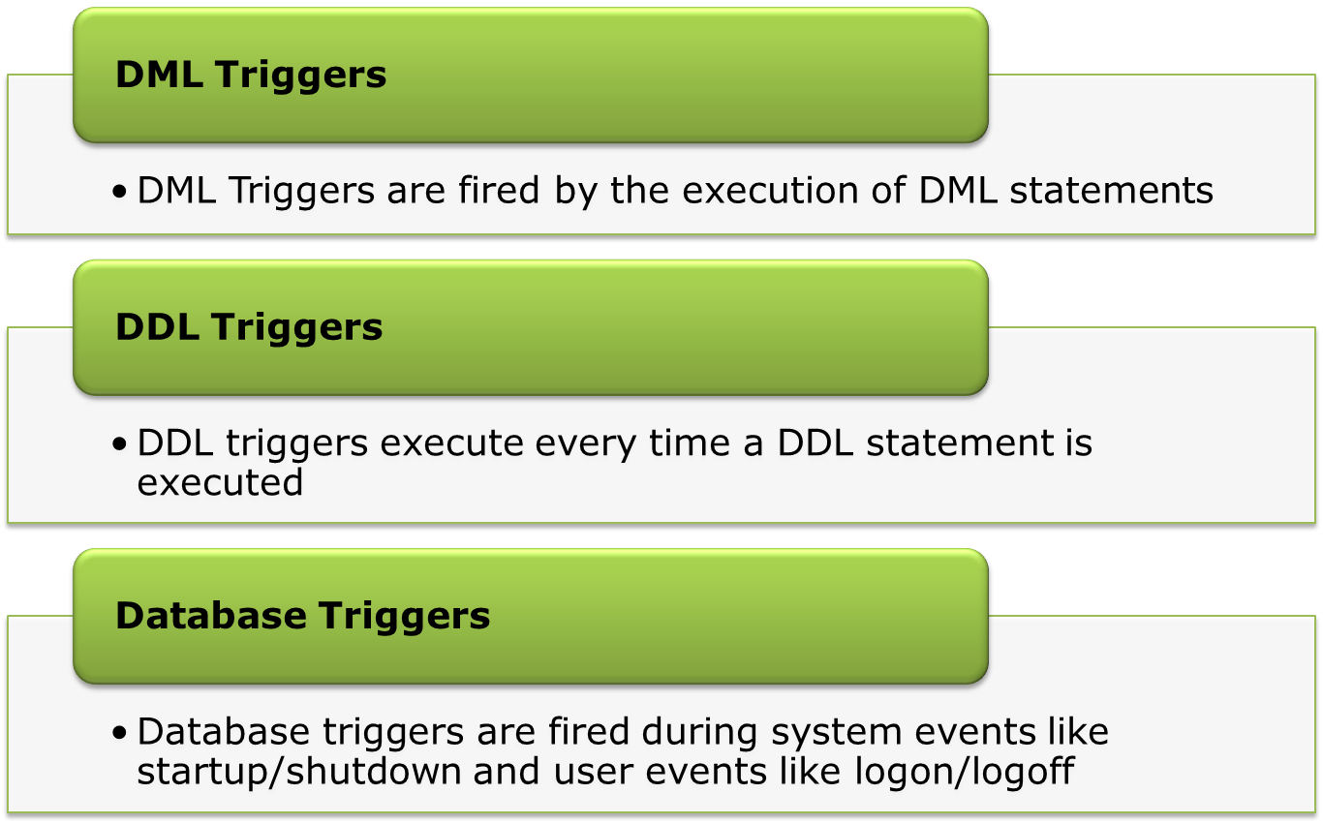
Types of Triggers

Slide 8

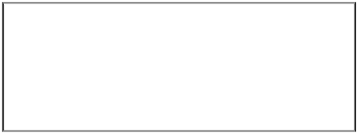
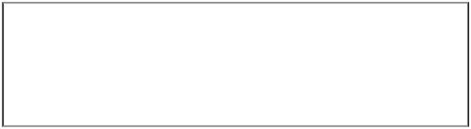




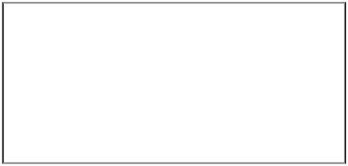
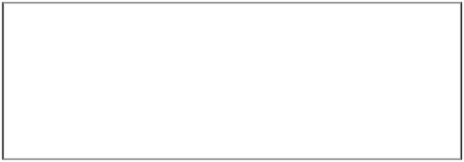
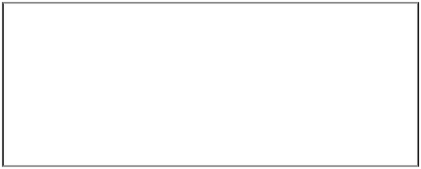









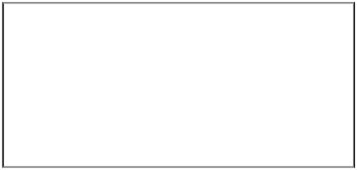
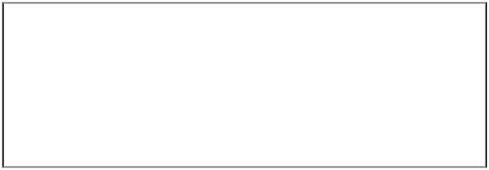




DML Triggers
DML Trigger Components
Part
Description
Possible Values
Trigger Timing
When the trigger fires in relation to the triggering event
BEFORE
AFTER
Triggering Event
Which data manipulation operation on the table or view, causes the trigger to fire
INSERT
UPDATE
DELETE
Trigger Type
How many times the trigger body executes
Statement
Row
Trigger Body
What action the trigger performs
Complete PL/SQL Block

Slide 9
DML Triggers
User Process
Start
Server Process
DML
Main Transaction
Trigger code
Commit

Slide 10
Statement Triggers
The trigger body executes only once for the triggering event. This is the default.
Syntax:
    CREATE [ OR REPLACE ] TRIGGER trigger_name
    trigger_timing event1 [ OR event2 OR event3 ]
    ON table_name
    PL/SQL Block;

Slide 11
Statement Triggers: Example
CREATE OR REPLACE TRIGGER chk_time
BEFORE INSERT OR UPDATE OR DELETE
ON service_request
BEGIN
IF (TO_CHAR(sysdate,’DY’) IN (‘SAT’,’SUN’)) OR (TO_CHAR(sysdate,’HH24’) NOT
BETWEEN ‘08’ AND ‘18’)
THEN
RAISE_APPLICATION_ERROR
(-20400, ‘You can not perform any DML Operation’);
END IF;
END;
Notes:
Note : The Trigger will be fired if on Saturday or Sunday or after office hours( 8am to 6pm) a user tries to perform any DML operation on the EMP table.
When a database trigger fails, the triggering statement is automatically rolled back by the Oracle Server.

Slide 12

Row Triggers
The trigger body executes once for each row affected by the triggering event.
Syntax for creating Row Triggers:
CREATE [ OR REPLACE ] TRIGGER trigger_name
trigger_timing event1 [ OR event2 OR event3 ]
ON table_name
FOR EACH ROW
[WHEN condition]
PL/SQL Block;
FOR EACH ROW: Designates the trigger to be a row trigger
WHEN condition: Specifies the trigger restriction
For the UPDATE event there is an optional clause
[OF column_name[,column_name…..]]
Notes:
Before / for each row trigger
A before trigger is called before because it fires before the new values (:new.field_name) are stored in the table. That means that the new value can be changed in the trigger.
This type of trigger is frequently used in the following situations:
When the trigger action should determine whether that triggering statement should be allowed to complete. This allows you to eliminate unnecessary processing of the triggering statement and its eventual rollback in cases where an exception is raised in the triggering action
To derive column values before completing a triggering INSERT or UPDATE satement.
After / for each row trigger
In contrast to a before trigger, an after trigger does not allow to change (:new.field_name) because when the trigger fires, the value is already written to the table.
If one tries to assign a value to (:new.field_name), Oracle throws an ORA-04084: cannot change NEW values for this trigger type.
This type of trigger is frequently used in the following situations:
When you want the triggering statement to complete before executing the triggering action.
If a BEFORE trigger is already present, and an AFTER trigger can perform different actions on the same triggering statement.
Performance Impact
AFTER row triggers are slightly more efficient than BEFORE row triggers. With BEFORE row triggers, affected data blocks must be read (logical read, not physical read) once for the trigger and the again for the triggering statement.
Alternatively, with AFTER row triggers, the data blocks must be read only once for both the triggering statement and the trigger.
For UPDATE event we can have the optional clause [OF <column name>]
When this clause is mentioned the trigger body will be executed only when in the update operation the value of the column mentioned is updated thereby improving on the execution efficiency of the code.

Slide 13

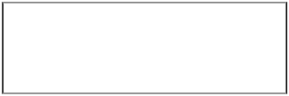
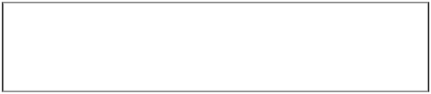
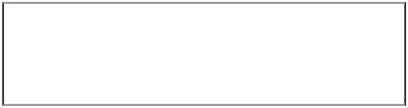



Using OLD and NEW Qualifiers
In a ROW LEVEL trigger all the column values of the current row, before modification and after modification, are available to the trigger block as local variables. To access these values, the OLD and NEW quantifiers are used
e.g. :OLD.empno, :NEW.deptno
Data Operation
Old Value
New Value
Data Operation
Old Value
New Value
INSERT
NULL
Inserted Value
INSERT
NULL
Inserted Value
UPDATE
Value before update
Value after update
UPDATE
Value before update
Value after update
DELETE
Value before delete
NULL
DELETE
Value before delete
NULL
Notes:
CREATE OR REPLACE TRIGGER chk_emp_sal
AFTER UPDATE OF sal
ON emp
FOR EACH ROW
BEGIN
IF :NEW.sal < :OLD.sal
THEN
RAISE_APPLICATION_ERROR(-20101,’Salary cannot be decremented’);
END IF;
END;

Slide 14
:old and :new variables: Example
  CREATE OR REPLACE TRIGGER chk_sr_id
  AFTER UPDATE ON service_request
  FOR EACH ROW
  BEGIN
  IF :OLD.sr_id <> :NEW.sr_id THEN
  RAISE_APPLICATION_ERROR
  (-20002, 'You can not Change Service Request Id');
  END IF;
  END;
Notes:
Above Example: To restict Service Request Id Modification
Use of UPDATE OF <column name>
If a triggering statement includes a column list, the trigger is fired only when one of the specified columns is updated. If a triggering statement omits a column list, the trigger is fired when any column of the associated table is updated. A column list is applicable only for UPDATE triggering statement and cannot be specified for INSERT or DELETE triggering statements.

Slide 15
Sequence of Execution of Triggers
Multiple triggers can be created on the same table for the same event.
The order of execution is as follows
  Execute all BEFORE STATEMENT triggers
  For each row in the target table:
  (a) Execute all BEFORE ROW triggers
  (b) Execute the DML statement
  (c) Perform integrity constraint checking
  (d) Execute all AFTER ROW triggers
  Execute all AFTER STATEMENT triggers

Slide 16




Sequence of Execution of Triggers
Single-Row Manipulation
Multi-Row Manipulation
1
1
Before update (Statement)
Before insert (Statement)
Before insert (For Each Row)
5
Before update (For Each Row)
INSERT INTO SERVICE_AREA
VALUES(104,'Adjustment‘,3);
UPDATE CUSTOMER
SET CUST_TYPE='Gold';
After insert (For Each Row)
After insert (Statement)
1
After update(For Each Row)
After update (Statement)
5
1

Slide 17
Sequence of Execution of Triggers: Example
CREATE OR REPLACE TRIGGER t1 BEFORE UPDATE ON emp
BEGIN
DBMS_OUTPUT.PUT_LINE
('This is statement level before update trigger');
END;
CREATE OR REPLACE TRIGGER t2 BEFORE UPDATE ON emp FOR EACH ROW
BEGIN
DBMS_OUTPUT.PUT_LINE
('This is row level before update trigger');
END;
CREATE OR REPLACE TRIGGER t3 AFTER UPDATE ON emp FOR EACH ROW
BEGIN
DBMS_OUTPUT.PUT_LINE
('This is row level after update trigger');
END;
CREATE OR REPLACE TRIGGER t4 AFTER UPDATE ON emp
BEGIN
DBMS_OUTPUT.PUT_LINE
('This is statement level after update trigger');
END;
Notes:
To check the working of the above triggers, issue the following DML statement
SQL> UPDATE emp SET sal = sal+450 WHERE deptno=10;

Slide 18
Summary
In this session, we have covered,
Trigger creation
Stored procedures vs Triggers
Types of Triggers
Sequence of Execution of Triggers

Slide 19
Thank You

